Slide 1
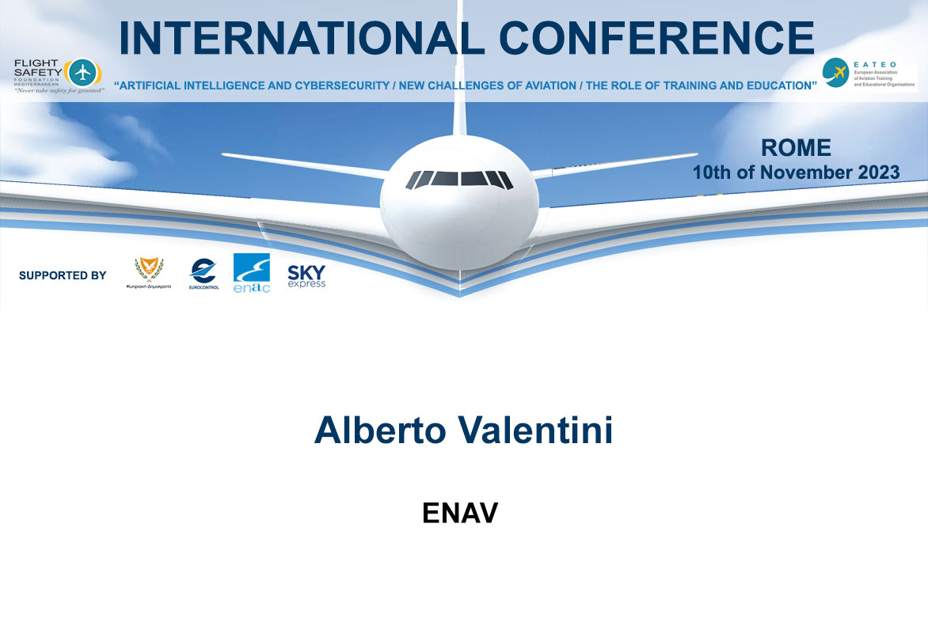

Slide 2



ENAV Training
Roma 10th/11/2023

Slide 3
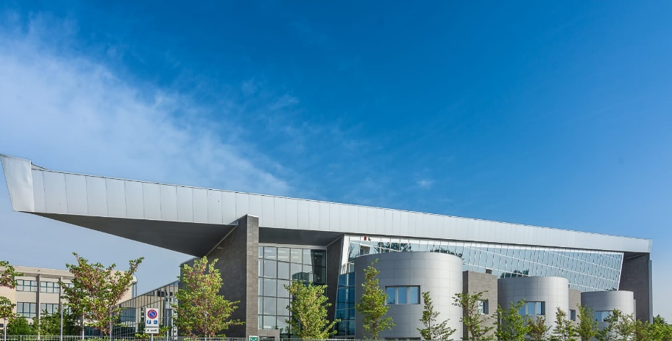
Enav Training Center
Future Expectations
ENAV Training Pillars

Slide 4
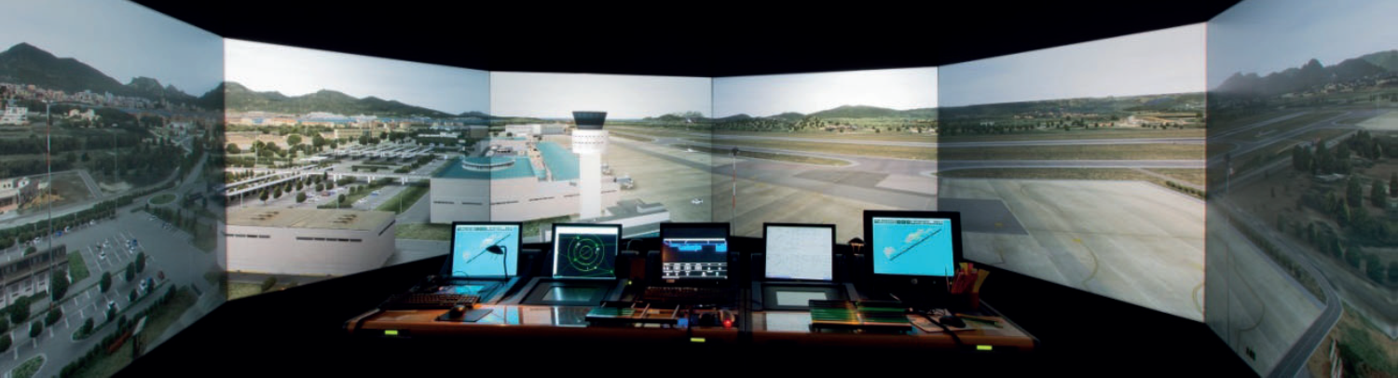
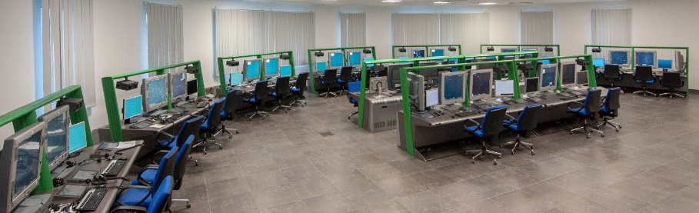
Realistic training environment, modern training methods and infrastructure, a pool of high qualified and experienced trainers to answer our Customers’ toughest needs:
ENAV Training Center, the value of training
Training Facilities and state-of-the-art Simulators
Areas of Excellence
Trainings
Forlì Training Center:
2 radar simulation rooms (24 positions)
1 procedural control simulation room
5 3D 270° control tower simulators
1 Remote Tower Simulator
1 CRJ flight simulator
8 STD (Simulator Training Device) portable
6 classrooms
Specialised library
1 multimedia classrooms (24 stations)

Slide 5
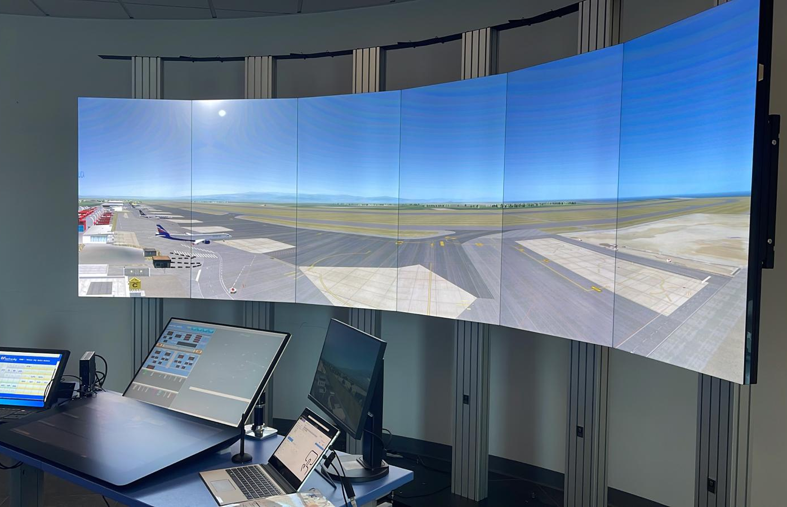
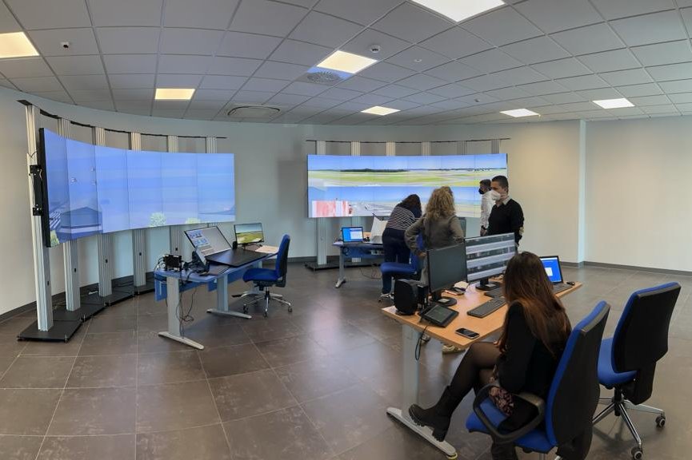
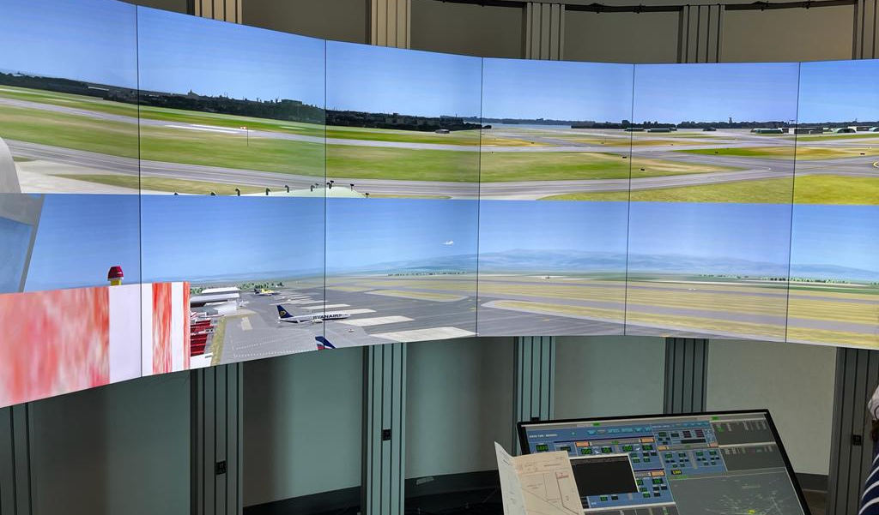
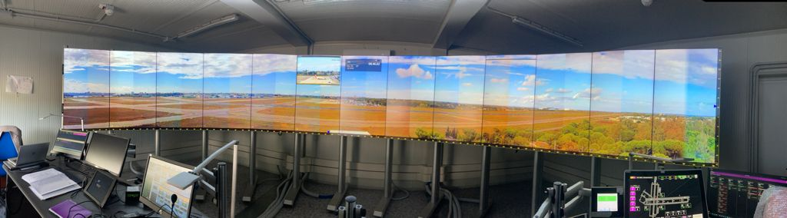

Slide 6

Current contest
End of Pandemic
War in Ukraine
Energy crisis
War in Middle East
Recovery of airlines
ATCO deficiencies in Europe

Slide 7
What we are doing at the Training Center
Hiring Opportunities
By the first half of 2024 we’ll complete the hiring process of 158 new ATCOs and FISOs, in 2023 we hired 38 former military ATCOs
Total new resources hired: 196

Slide 8

What we are doing at the Training Center
Hiring from the inside, upgrading personnel
By the first months of 2024, the process of upgrading 135 Flight Information Service Officers into Air Traffic Controllers will be completed .
Total new resources hired: 135

Slide 9

  New ATCOs Hired
By the end of the 2024 training season, 249 new ATCOs/FISOs will be hired and engaged in the Operational Lay-Out.
Now the question is:
By 2026, how many ATCOs will retire????
400

Slide 10
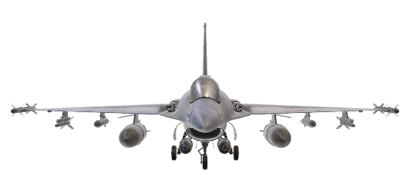


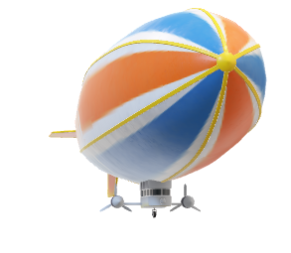
Methods, Objectives and main Pillars of ENAV Training
Safety
Quality of service
Cost Efficiency
Sustainability

Slide 11
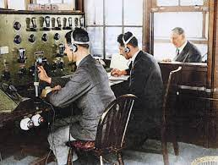
Next Gen ATCO
Along with safety, our training has to be a «quality-oriented training»
What do airliners ask for?
Cost efficiency
What is the Aviation world asking for?
Sustainability

Slide 12
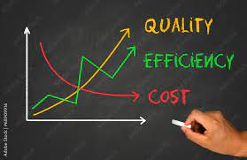
Inside each training process our main focus is «Safety»
Additional objectives of ENAV Training are: Quality of service, Cost Efficiency, Sustainability
If our training model is quality oriented, we’ll meet «cost efficiency» expectations,
If we are able to achieve «Cost Efficiency» results, we can also reach «sustainability»
How do we achieve these goals?
The best possible training, with technology innovation and innovative projects

Slide 13
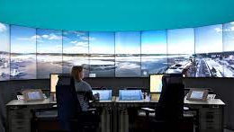

New training concept
The «best training possible», according to «Competence Based Training and Assessment», the goal is «performance», along with customer expectations and how we should get to it.
ATCOs 2.0:
at the end of each training process, the trainee shall be able to provide a high-performance/quality level of service, including cost efficiency and sustainability

Slide 14
IMPLEMENTATION PROGRAMMES
REMOTE TWR
Free route airspace from FL 195, Cross Border with Balcanic Area
NEW CWP and New Radar system – for Area Center CO-FLIGHT/4-FLIGHT
NEW EFPS (ELECTRONIC FLIGHT PROGRESS STRIP for TWR)
ACC IMPLEMENTATION PROGRAMMES – APP IN ACC

Slide 15
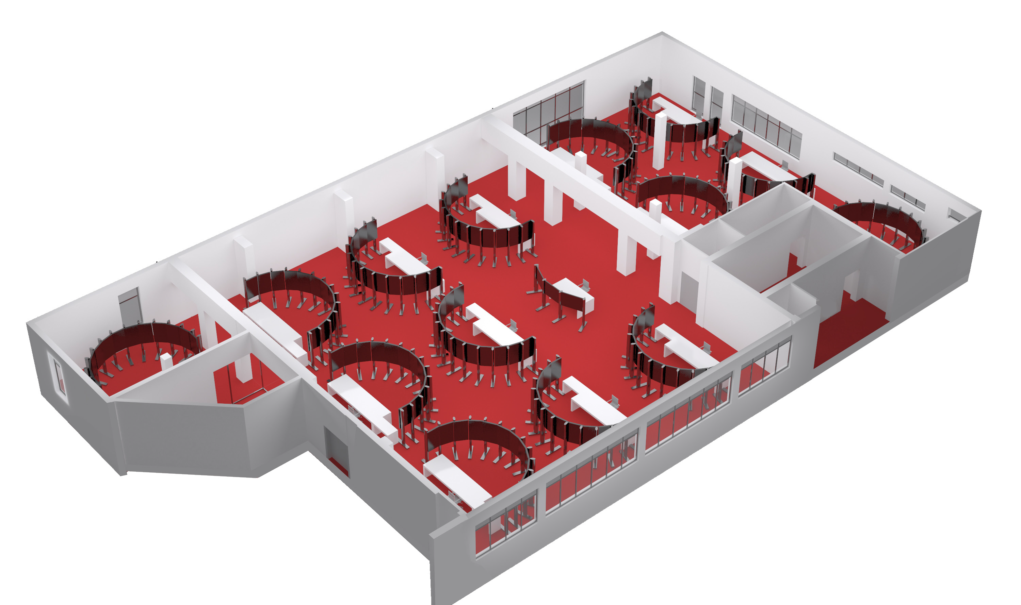
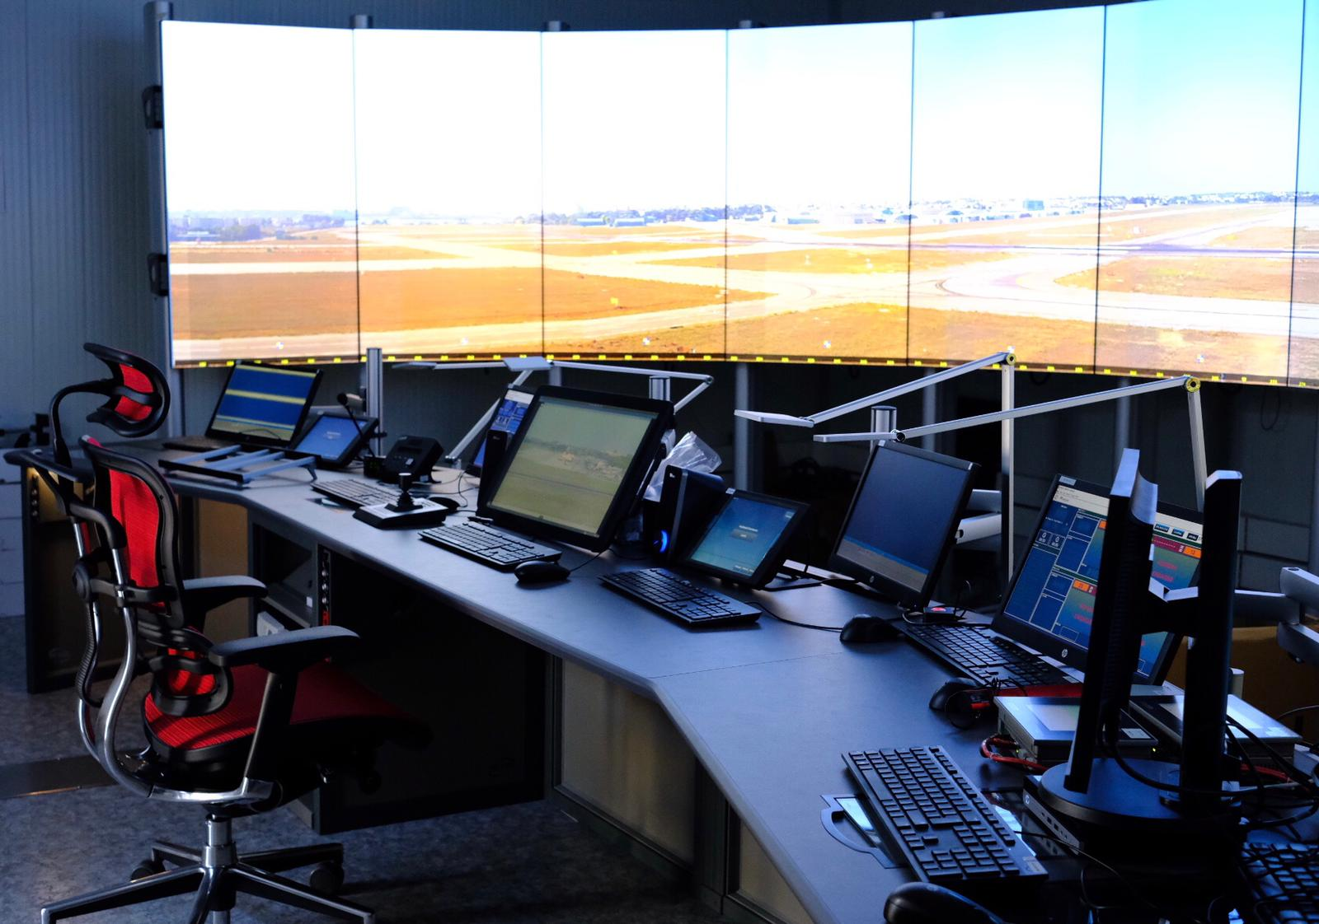
TWR IMPLEMENTATION PROGRAMMES – REMOTE TWR
  First Digital TWR Brindisi 2022
  Next Digital TWR Perugia 2024
  Remote TWR Control Centre LIBR 2024
2024
2024
  3 additional Remote TWRs

Slide 16
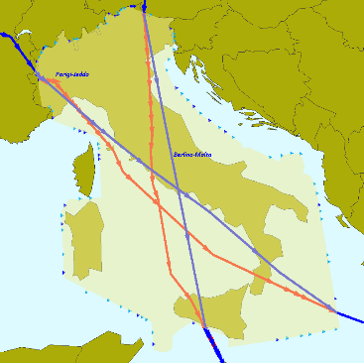
Free Route FL 195
FRA with Malta March 2024, Cross Border with Balcanic area
Lowering Free Route Airspace down to FL195

Slide 17


Next step
Artificial intelligence
At the moment there are no alternatives to the human ATCO
To ensure safety in flight is still a need for man or women
We are designing artificial intelligence solutions for simulations, where there is the possibility of flexible use, mainly to improve training techniques.
Quality of training = safety

Slide 18

THANKS FOR YOUR ATTENTION
enav.it

